Slide 1

Real-Time Voice Transcription

Slide 2
The Luxembourg government faces an urgent need to automate the transcription of press conferences to improve the diffusion of public information
Challenges
Manual Transcription and Translation in Multilingual Press Conferences
Significant Delays
Manual transcriptions delay the publication of press conferences. This penalizes quick access to crucial information and is not suitable for emergency situations or important announcements
Multilingualism
Multilingual conferences require additional manual translation
The manual translation process extends the publication delay
Costly Resources
Costly mobilization of resources for transcription and translation
High costs for the government and human errors

Slide 3
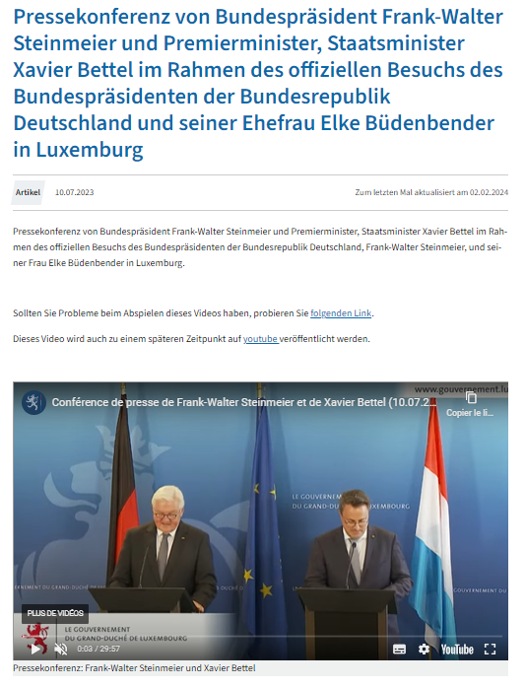
Current manual transcriptions delay the publication of information, reducing its accessibility
80%
80% of press conferences are manually transcribed by the Service Information Presse du Gouvernement
30%
30% of conferences cover topics requiring rapid diffusion
4
Press conferences are held in 4 languages: Luxembourgish, French, German, English
>1h
The average manual transcription delay ranges from several hours to several days

Slide 4



AKABI is implementing a real-time transcription solution based on fine-tuned AI models for Luxembourgish and other European languages
Performance
Artificial Intelligence Models
Business Impact
Low latency transcription (<500ms)
Real-time multilingual management
Automatic language switching
Integration into live streams (YouTube, Facebook)
OpenAI's Whisper
Lemswasabi
ZLS
Voxlingua107
AI automation of the transcription process
Archived videos benefit from transcriptions
Automatic Speakers separation
Diffusion of critical information without delay
Reduction of operational costs related to manual transcription
Notes:
Secure deployment: Leveraged Azure OpenAI to implement a scalable, secure, and compliant infrastructure for AI use across the organization.

Slide 5



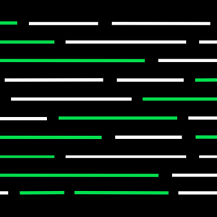





A robust and specialized technical stack to support real-time multilingual transcription
1x Senior Data Scientist (6 months) 1x Medior Data Scientist (3 months) 1x Medior Data Engineer (3 months)
Hugging Face Whisper PyTorch GPT-4 Streamlit Flutter TensorFlow Anaconda JupyterLab

